Slide 1
Welcome to our New Yr.7 and Parents
M Cramer

Slide 2
Introductions
Mr Cramer, English Teacher
23 years at Greenford High; approximately 10 years as Head
Parents – you may be more nervous than your sons/daughters about coming to High School!
Question slips – to answer your queries. Also, we are available at the end for individual questions

Slide 3
Place at GHS
Congratulations on getting a place
Non-selective school: we take every faith, including those without faith. Every culture, boys and girls, from across the whole spectrum of abilities
We have had for several years:
Highest amount of applications in Ealing
Highest amount of first choice applications
600 approximately on our waiting list

Slide 4
Transition
The closest community to the school: within .7 of a mile
Shortly – your sons and daughters will be GHS students, not Lady Margaret, Gifford, Stanhope, Ravenor etc.
They will feel some loss at this – big change in life: they are growing up. To help them:
i-Block – Yr 7 only; stepping stone; place of transition; a small school within a large campus

Slide 5
Significant Dates at GHS
First Day: Weds 5th Sept.
Possible delays with the new buildings – furniture and ICT contractors
We will contact you as soon as possible if there is a revised start date.
We will also to our very best to ensure that any delay is as short as possible.

Slide 6
Significant Dates at GHS
Thursday 1st November – Meet the Tutors Evening
Thursday 28th February – Meet Subject Teachers Evening
Friday 5th April – Raising Achievement Day
Reports – 3 per year, plus end of year exam results

Slide 7
Significant Dates at GHS
In this Hall:
July 2020, Yr 8 graduation
August 2021 – First GCSE results
June 2023 – Yr 11 Prom
August 2023 – Final Yr 11 GCSE Results
Last day:
August 2025 (A Level Results Day)

Slide 8
Deputy Headteacher – Ms A Johal

Slide 9
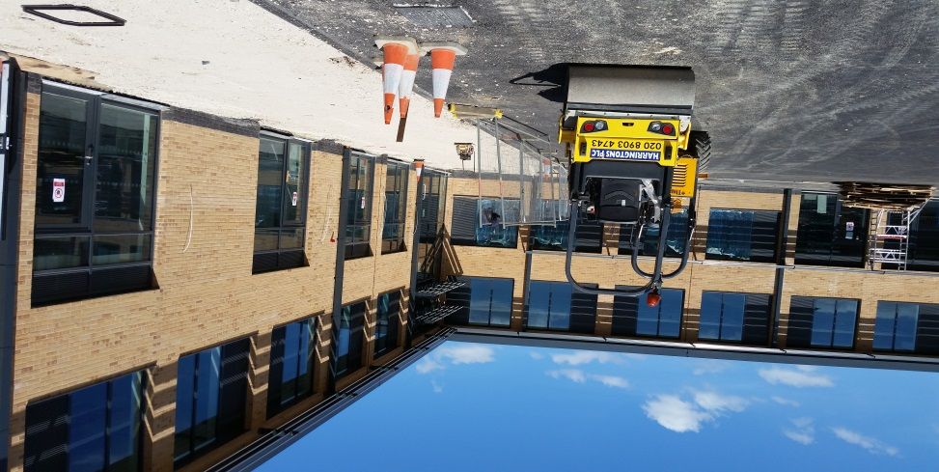
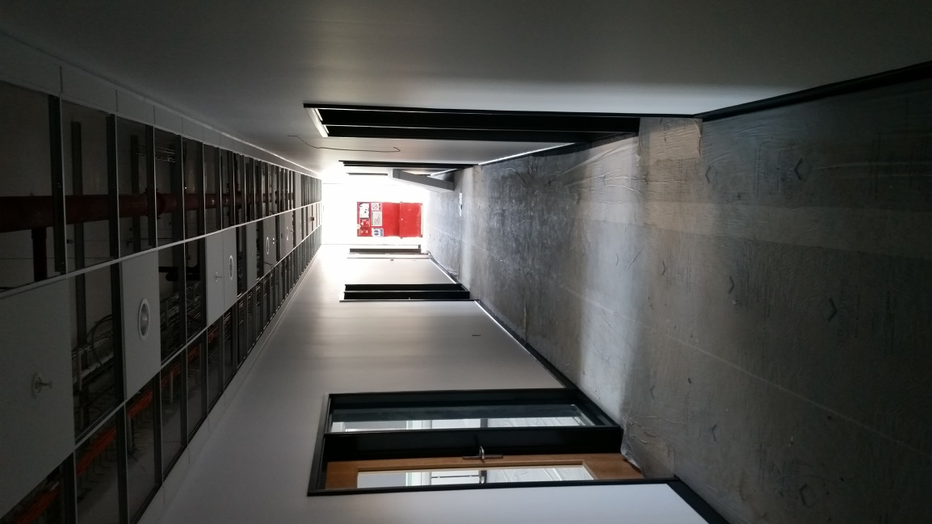
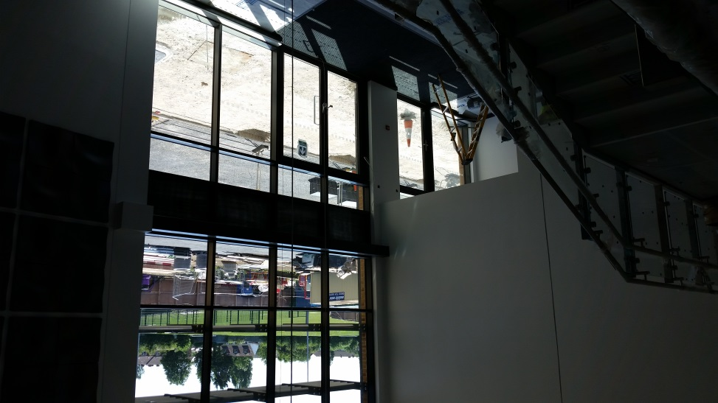
The ‘i’ Block

Slide 10
Three Top Tips

Slide 11
Develop Routines
  Morning routine
    Set an alarm
    Uniform laid out
    Breakfast
    Leave with enough time to get to school for 8:20
  After school
    Go home and eat a snack
    Start homework and complete it for an hour
    Pack bag for the next day
    Reading time – 20 min a day

Slide 12
Get Organised
  Perfect uniform
  The right equipment
  Bags packed everyday with the equipment and books they need
  They are at school everyday and on time
  They have somewhere to complete their homework everyday and they do all of their homework

Slide 13
Be Respectful
  Establish eye contact
  Use positive body language
  Smile
  Use professional language
    Good morning/bye
    How are you?
    Please
    Thank you
  Respect our guests, visitors and neighbours
  Open doors for one another
  Follow our school rules

Slide 14
Common Induction Day
Friday 29th June
Students need to arrive by 8:45am
They will be met in the foyer
Students should wear their primary school uniform
Lunch will be provided
Students will need:
  A pencil case
  Pair of trainers
The day will finish at 2:45pm

Slide 15
The Headteacher – Mr. Cramer

Slide 16
How can you help your child be successful?
Today we received 2 awards – we are in the top 5% of schools in the UK for student progress; we are in the top 5% of schools in the UK for student achievement
Over the last 4 years, 1,000 students have gone on to university.
Harvard, Princeton, Oxford, Cambridge… to excellent apprenticeships

Slide 17
How can you help your child be successful?
The bad news is, the success of other children, in the past, does not guarantee the success of your child
Each child is an individual and is unique
To succeed, we need all three elements of this triangle to work at its best:
Student
School
Parents
So, how can you help your son/daughter to learn to succeed?

Slide 18
How can you help your child be successful?
Reading test – we compare the student’s reading age against their chronological age
18
14
11
7
4
Every day, 20-30 minutes reading at home, sometimes aloud
Every day
What improves?

Slide 19
How can you help your child be successful?
Help them not jut to be on time, but to be early
Help them not to miss school
Average attendance – 96%. 90% - misses a day every two weeks. 80% - misses a day per week
Tell them to come straight home at the end of the day
Don’t take them away during term time

Slide 20
How can you help your child be successful?
Make sure they dress smartly
Make sure that their appearance is appropriate for school
Help your child pack their bags the night before
Make sure that they do their homework the day that they get it
Teach them good manners and respect
One school rule: Ready, Respect, Safe
Support us even when you don’t agree with us…
… because otherwise students take this as a signal that they don’t have to follow school rules

Slide 21
Final Reminders
Uniform – over the summer
Reading – over the holidays and beyond
Free School Meals – please claim
Questions – now, and in person afterwards
No need to turn up to the second session!
This presentation will be available on our website

